Slide 1
StyleBoost : A Study of Personalizing Text-to-Image Generation in Any Style using DreamBooth
Junseo Park, Beomseok Ko and Hyeryung Jang
Department of Artificial Intelligence
Dongguk University

Slide 2
“Style Training”
In a broader context

Slide 3
Table of Contents
Introduction
DreamBooth
StyleBoost
Experiment
Conclusion

Slide 4
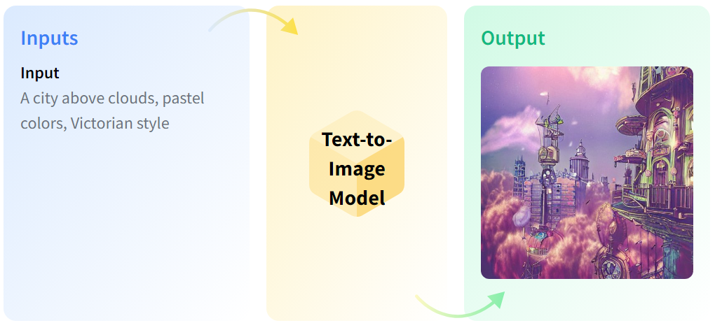
Introduction

Slide 5
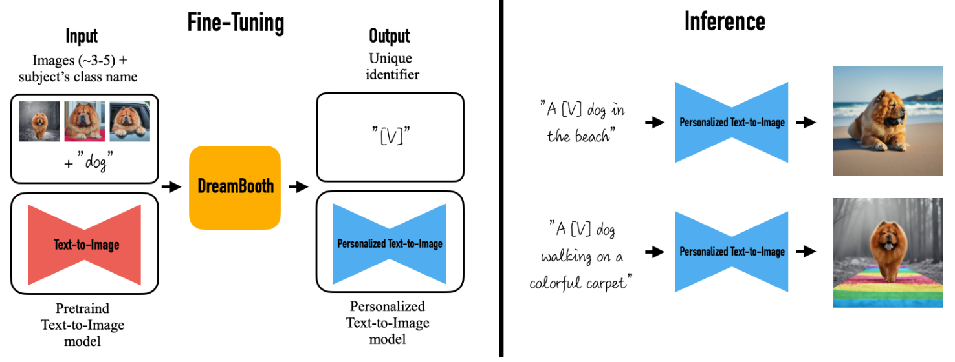
Introduction
<DreamBooth>

Slide 6
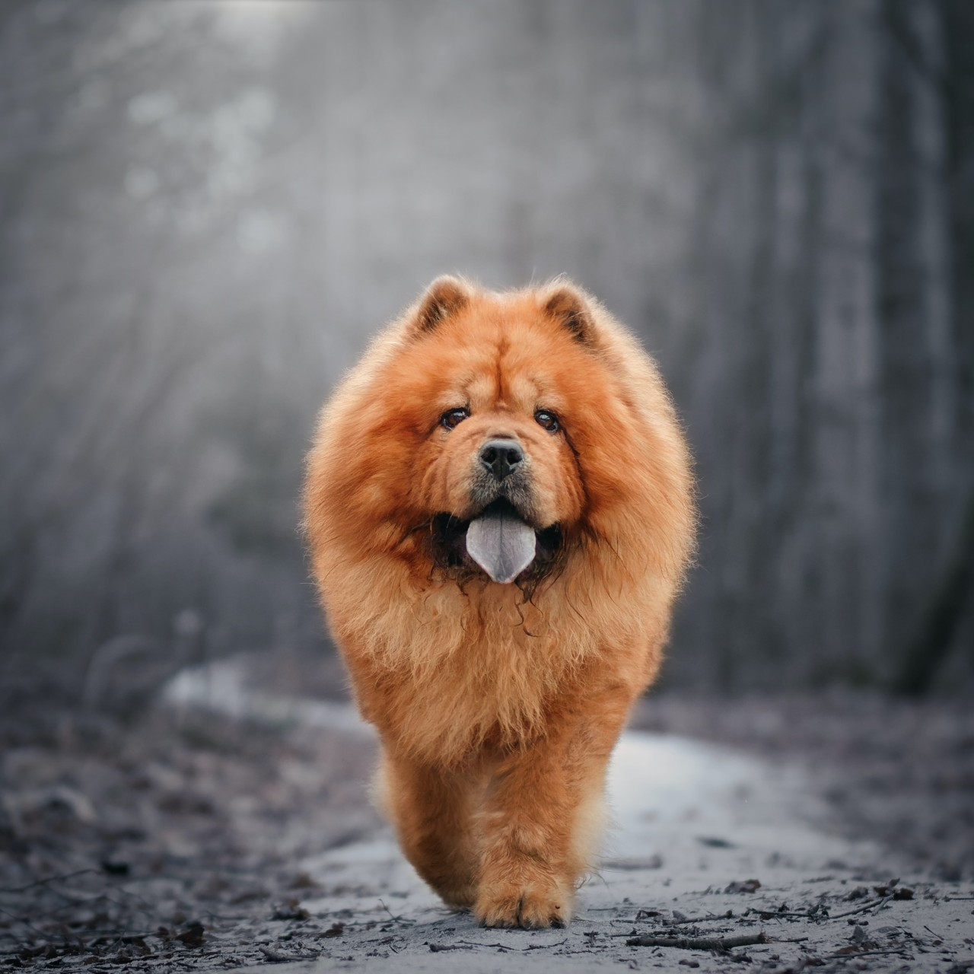
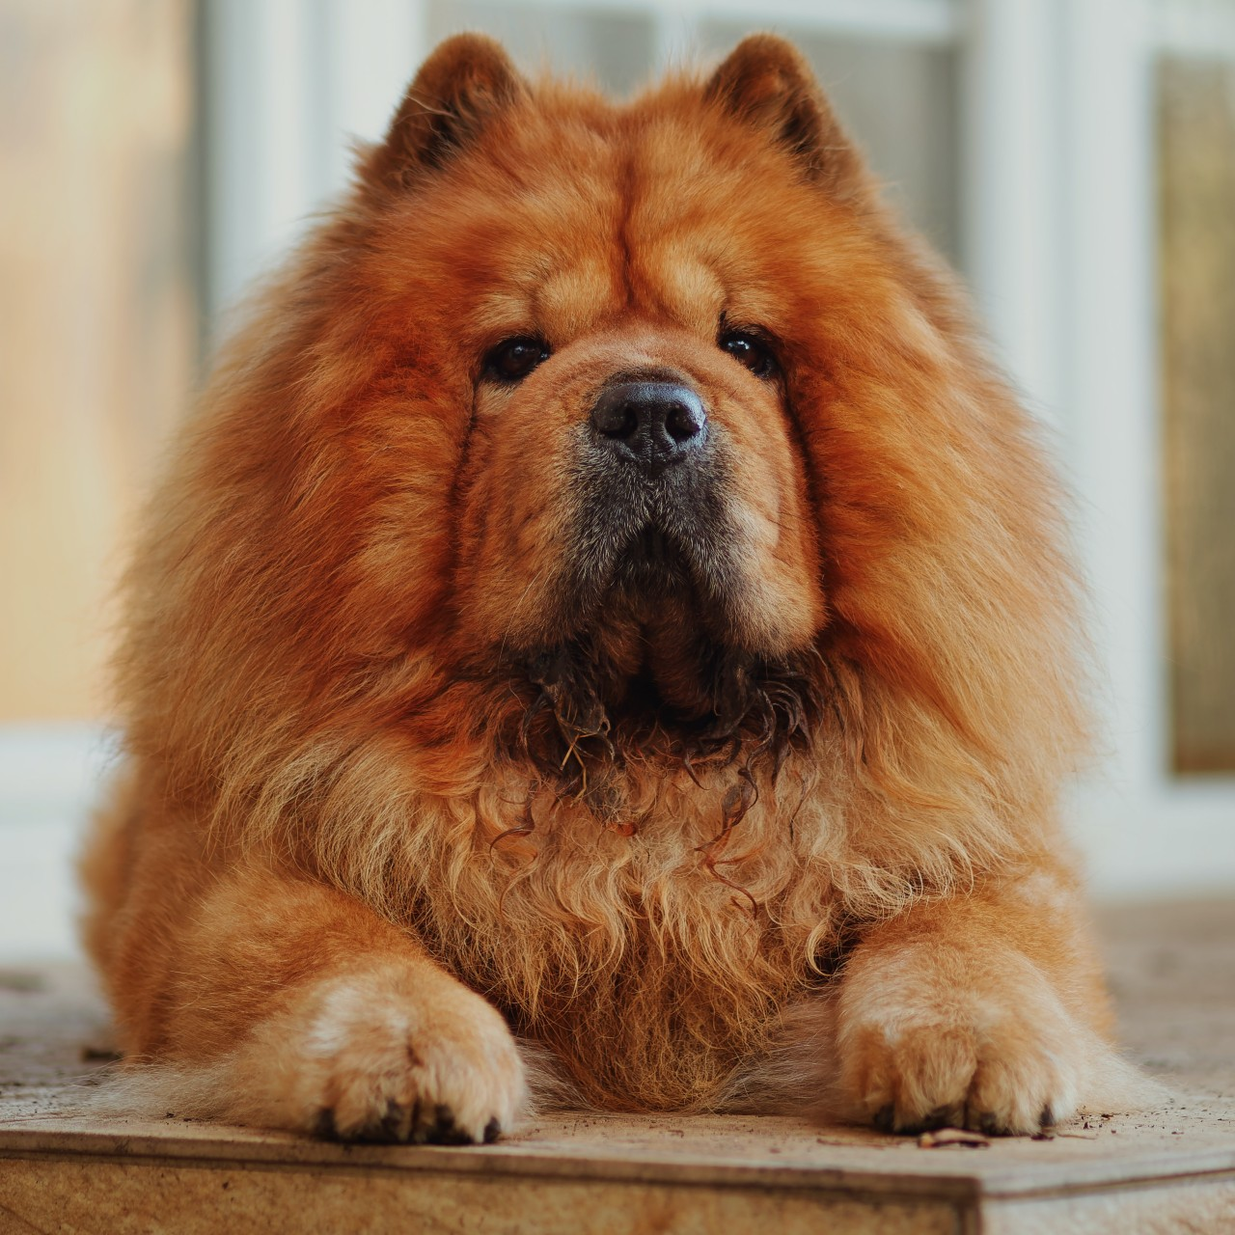
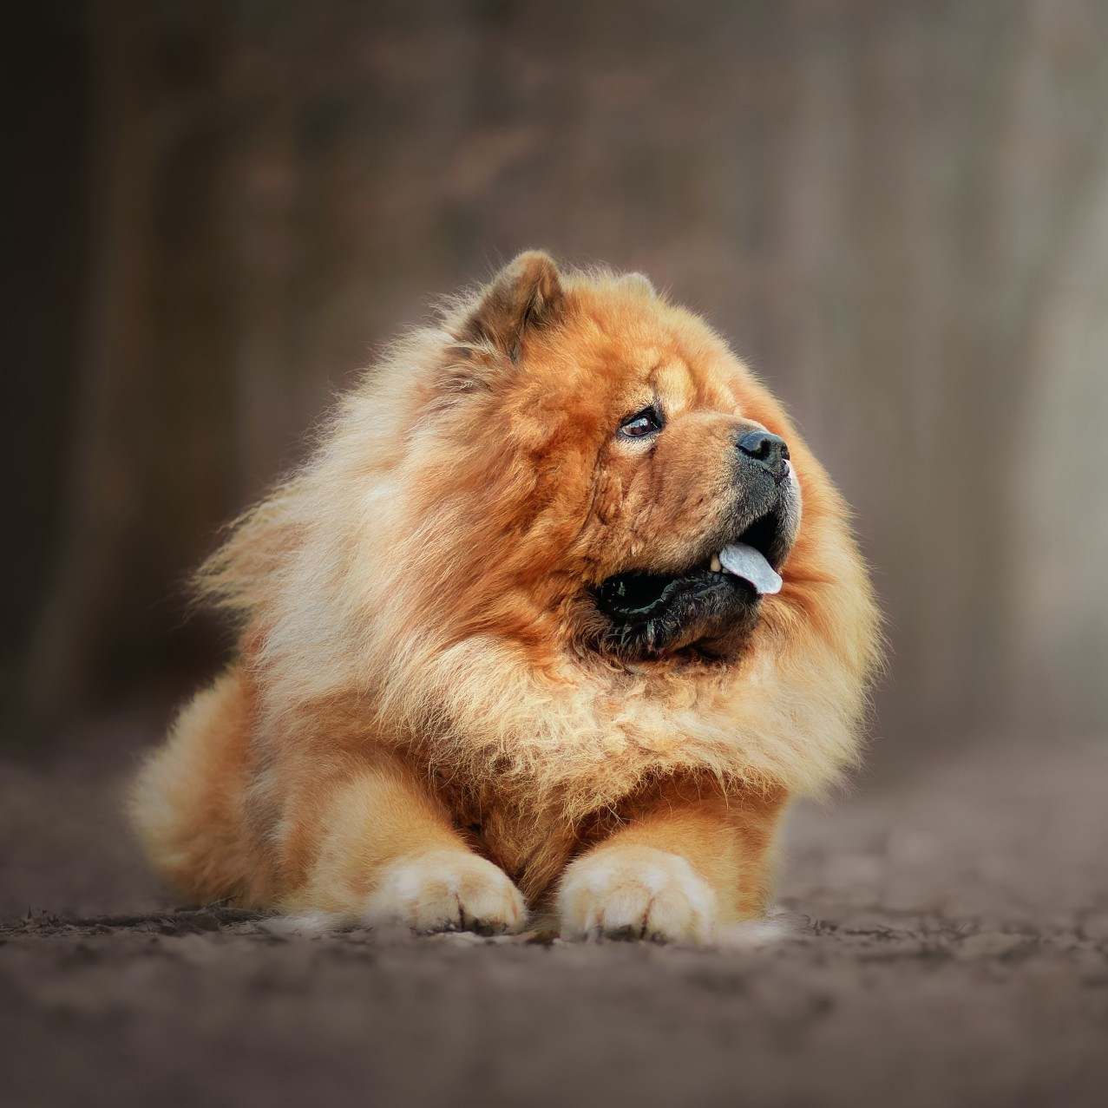

Introduction
Ours
DreamBooth
VS
Images(~3-5)
“ [V] dog ”
<DreamBooth>
Notes:
우리는 dreambooth의 framework를 사용한다. Baseline이기 때문에 dreambooth와 비교해서 말할꺼고 dreambooth에 대해서 먼저 설명해주겠다

Slide 7
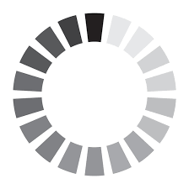
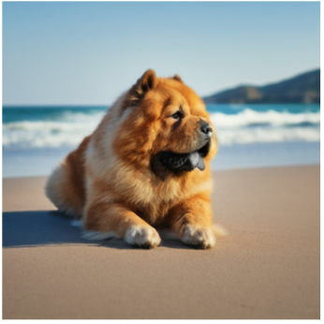

Introduction
②
training
Images(~3-5)
“ [V] dog ”
①
mapping
[V] : unique token (e.g. zwx)
Dog : class name
prompt
inference
“ A [V] dog in the beach”
③
④
<DreamBooth>

Slide 8
DreamBooth
Problem.
Overfitting
Language drift
training
Images(~3-5)
“ [V] dog ”
mapping

Slide 9
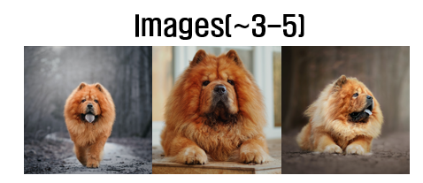
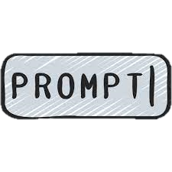



DreamBooth
Problem.
Overfitting : create an object or background of
Language drift
Text-image alignment

Slide 10
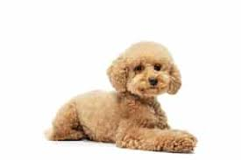
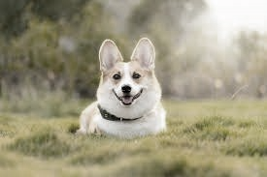
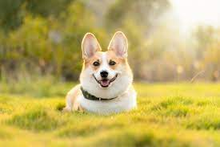
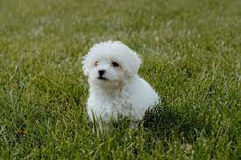
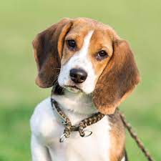
DreamBooth
Problem.
Overfitting
Language drift
A dog
Loses the various expressions of class name

Slide 11
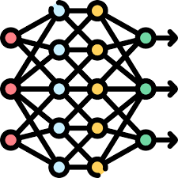

DreamBooth
Pre-trained diffusion
Class prior image
Dog
Introduce a class prior image
Class prior image is mapped to the class prompt
Generated from the pre-trained diffusion model
“ [V] dog ”

Slide 12



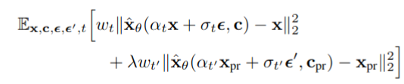
DreamBooth
Loss function
Diffusion model
[V] dog
Dog
Diffusion model

Slide 13
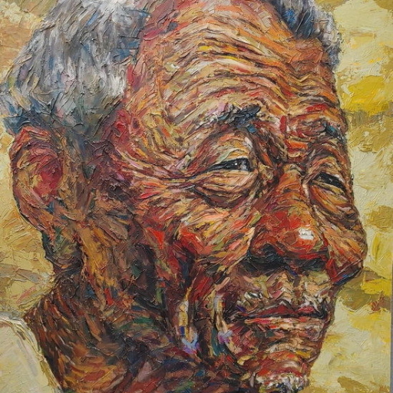
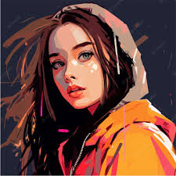
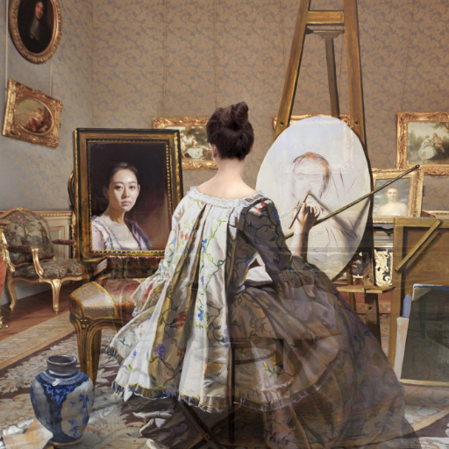
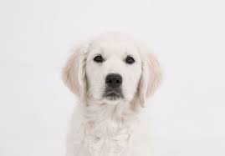
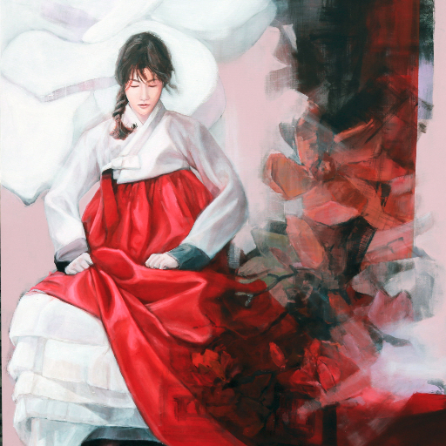
DreamBooth
“ [V] style ”
“ [V] dog ”

Slide 14
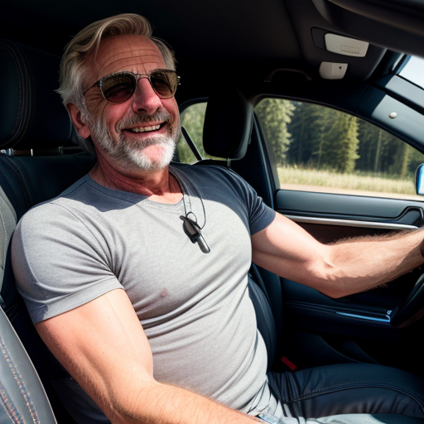
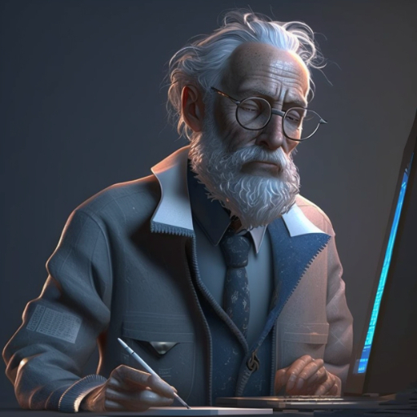

DreamBooth
Existing DreamBooth.
Experiment on three common styles
These styles are called target style we want to learn
<Target style>
realism
SureB
anime

Slide 15
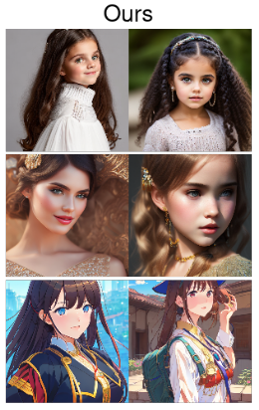
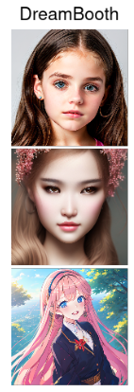
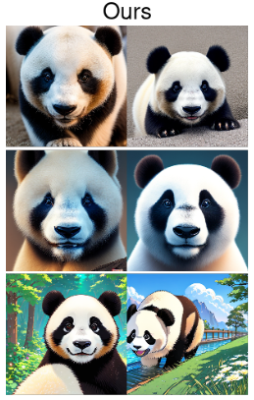
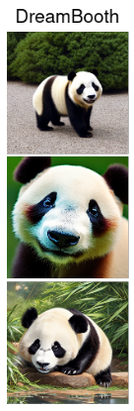
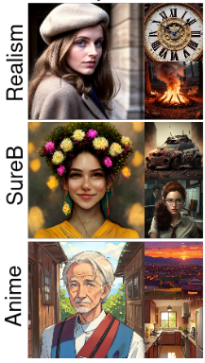
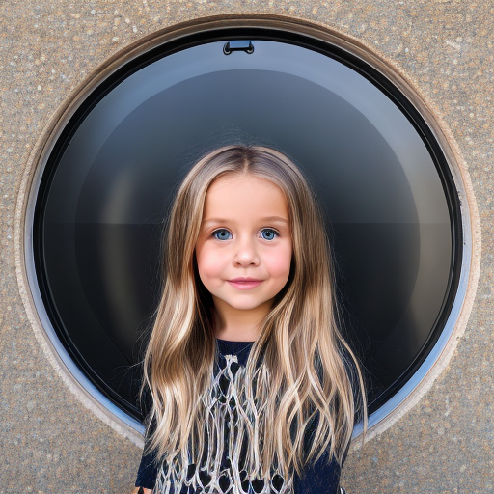
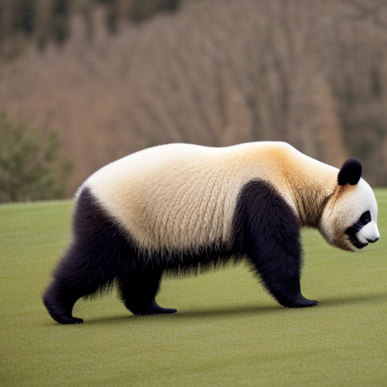
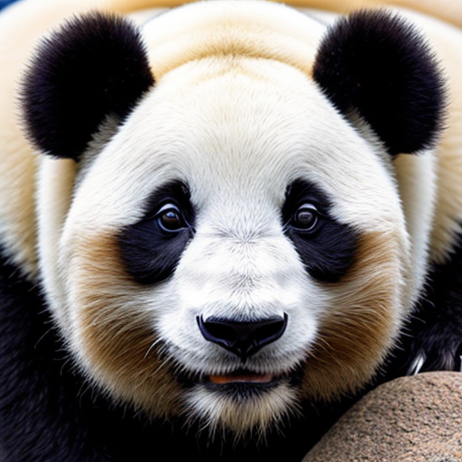
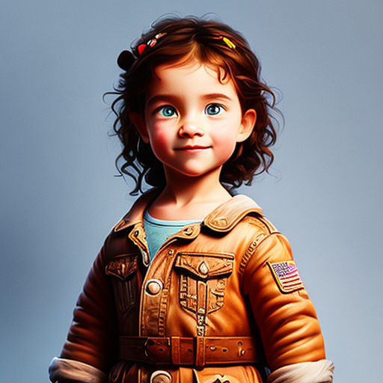
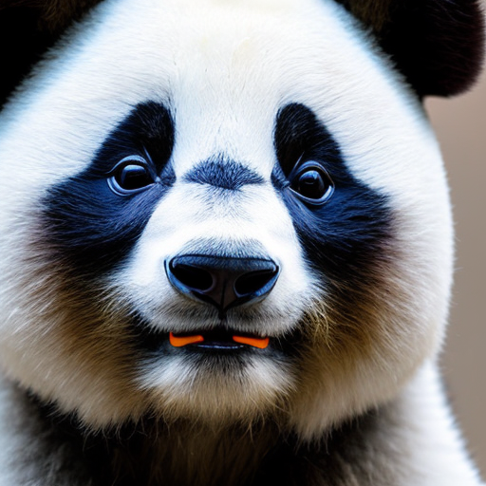
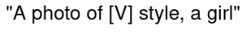
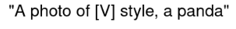

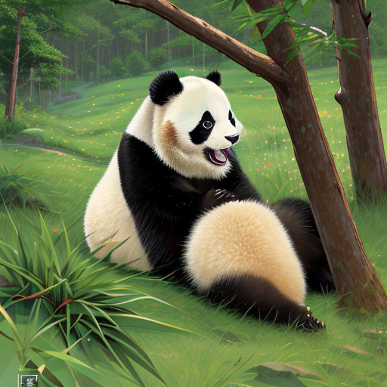
DreamBooth
VS Ours
Notes:
이걸 어떻게 만들었는지 보여주겠다

Slide 16
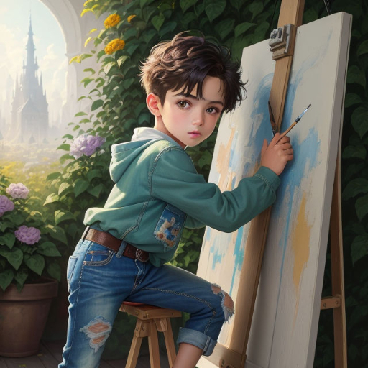
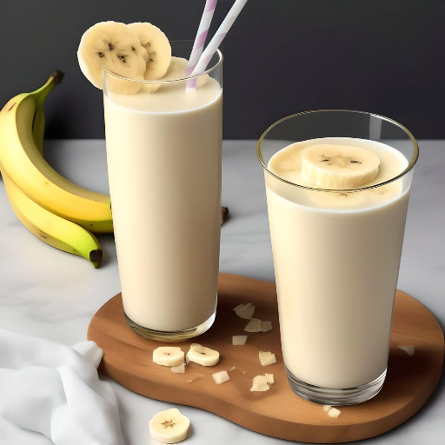
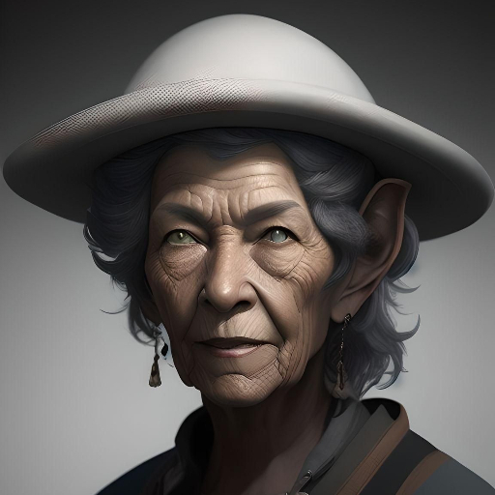
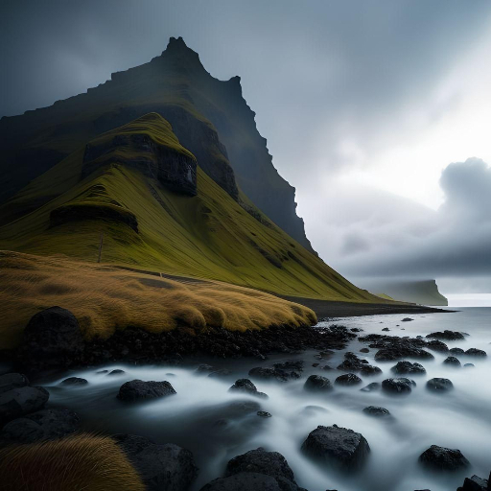
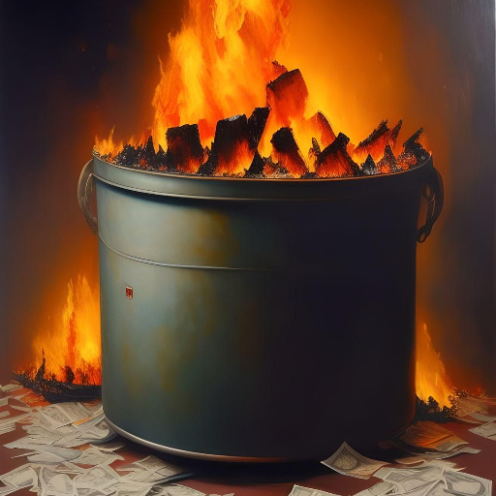

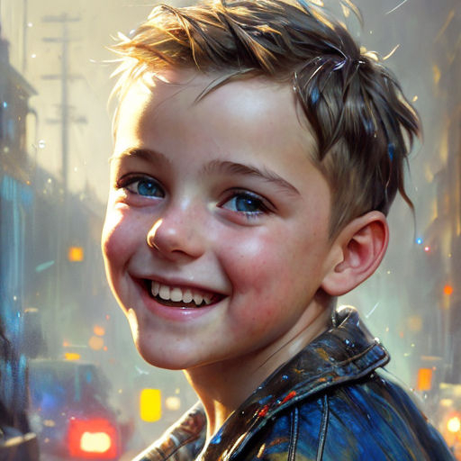
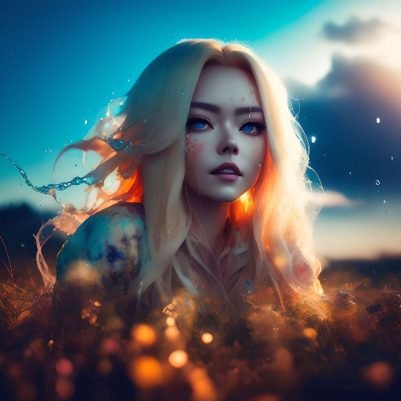
DreamBooth
Style is an abstract and broad concept
It is difficult to bind the region of style with 3 to 5 images
VS
Style
Object
…

Slide 17
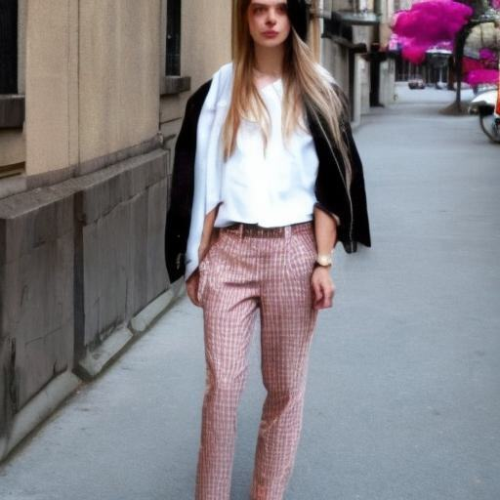
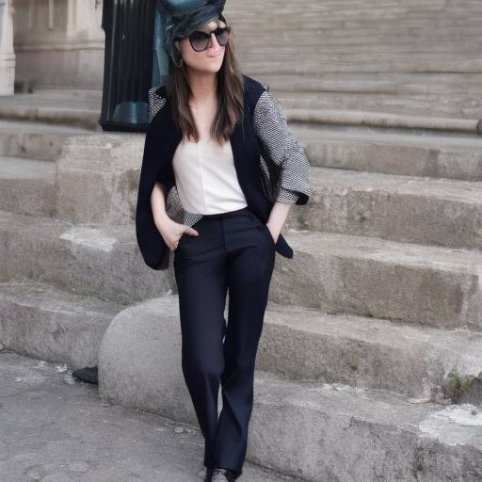
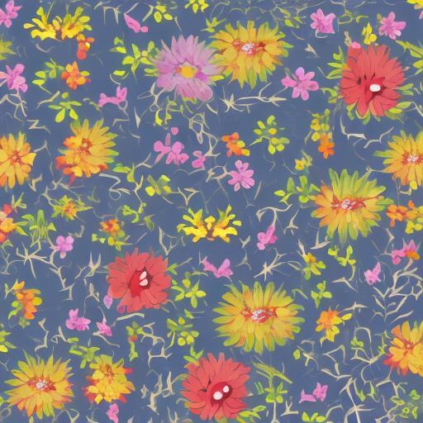
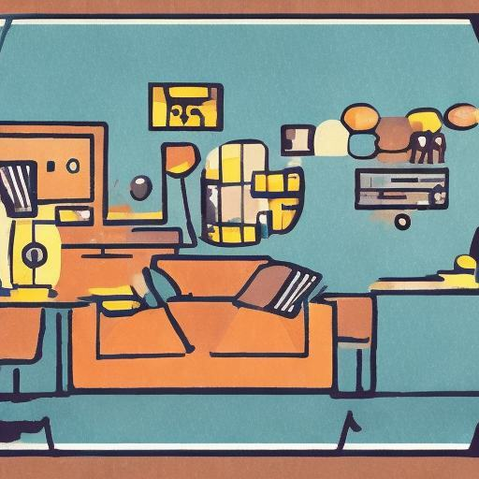
DreamBooth
Class prior image has no information to help with style training
Non art style
inconsistent art style
Pre-trained diffusion
Class prior image
Pre-trained diffusion
Class prior image
style
Illustration style
In DreamBooth
In DreamBooth
Notes:
왜 정보가 부족한지에 대한 설명이 필요

Slide 18
StyleBoost

Slide 19
StyleBoost
In ours,
Increase from 3-5 to ~20 images
We call this style reference image
B. Expand the class prior image to suit the purpose of style training
We call this auxiliary image

Slide 20
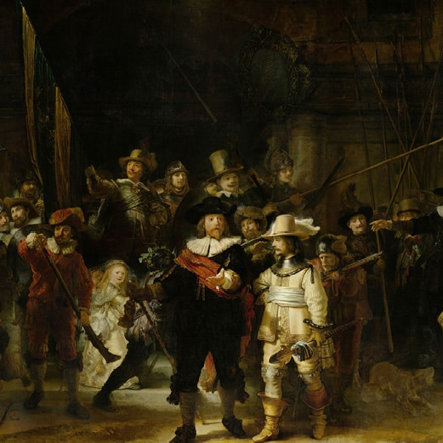
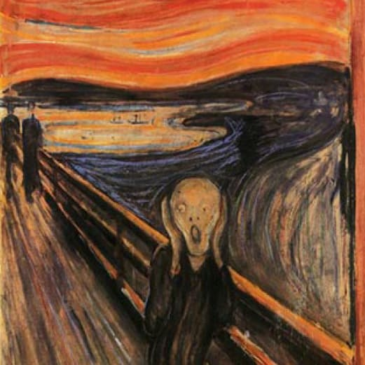
StyleBoost
While keeping the concept of fewer images, empirically found that 20 images were suitable
Style reference image
Images(~3-5)
Images(~20)
…

Slide 21
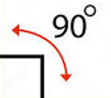
StyleBoost
Auxiliary image.
It is difficult to bind with style reference image alone
To boost binding process, configure auxiliary images as an image similar to the target style but with more general characteristics
Target style
Target style
Target style
Auxiliary
Auxiliary
Auxiliary
…
shape
texture
color

Slide 22


StyleBoost
Style
Things that have changed
Fashion style
Art style
Anything is possible within the category of style
Language drift is no longer a big deal
meaning
‘style’
token :
Fashion style in SD 1.5
Art style in ours

Slide 23

StyleBoost
Things that have changed
Auxiliary image is obtained with high-resolution and good quality in the Internet
Pre-trained diffusion
Class prior image
Auxiliary image
Style
In DreamBooth
In ours
Notes:
Language drift를 신경쓰지 않아도 돼서, 인터넷에서 좋은 퀄리티로 구할 수 있다.

Slide 24
Experiment
Setting.
Use Stable Diffusion v1.5 (SD1.5)
Experiment on three common styles
Evaluates with FID & CLIP scores
realism
SureB
anime

Slide 25
Experiment
FID $↓$
Quantifies the statistical similarity
Lower FID score indicates more similarity
CLIP $↑$
Measures the text-image alignment
Higher CLIP score corresponds to being aligned

Slide 26
Experiment
Assumption.
Learning optimal interval for each style was different
SD 1.5 starts with a style close to realism

Slide 27


Experiment : training steps
FID score
CLIP score
SureB
anime
anime
realism
SureB
Fewer training steps
- Overfitting mitigation
- Preserve text-image alignment
realism

Slide 28
Experiment : training steps
anime
realism
SureB
SD1.5
anime
SureB
realism
Depending on assumption, the more distant styles from realism, the more learning is needed
A large area can be bound with few training steps

Slide 29





Experiment : style reference image configuration
Only background or person
It has biased information
Create images reflecting the prompt
Only person
Only background
Mixture of background and person

Slide 30

Experiment : style reference image configuration
Background : 10 images
Person : 10 images
Since style consists of multiple elements, biased information can be learned by providing only one element
Mixing properly improves performance

Slide 31



Experiment : auxiliary image
Digital painting image
The overall smooth and sophisticated expression is implemented using the software tool

Slide 32
Experiment : auxiliary image
Use digital painting image as auxiliary image
Since all target style data sets are generated by the diffusion model, they have the characteristics of digital painting
Therefore, it satisfies the picture below
Target style
Target style
Target style
Auxiliary
Auxiliary
Auxiliary
…
person
texture
color

Slide 33

Experiment : auxiliary image
Auxiliary images help with binding
Performance of FID & CLIP scores is improved by adding an auxiliary image

Slide 34
Experiment
VS DreamBooth
Notes:
다음의 실험들로 만든 결과다

Slide 35

Introduction
VS DreamBooth
FID score
Notes:
FID 상으로도 성능이 좋다. 즉 넓은 의미의 스타일링을 완성

Slide 36
Conclusion
Results
Still proceed with learning with fewer images
Due to fewer training steps, there is an overfitting mitigation effect and text-image alignment can be preserved
Core idea
To bind the abstract concept of 'style’ we transformed DreamBooth's class prior image into an auxiliary image, serving as a secondary binding

Slide 37
Conclusion
Application
You can receive a style guide just by providing a few images
What to improve
Experiment with more diverse styles more diverse comparison groups (LoRA, Textual Inversion etc.)

Slide 38
Thank you
Email : mki730@dgu.ac.kr

